Slide 1
URMC Caregiver Team

Slide 2
Objectives (March 2)
Data preprocessing:
○Clean and classify cancer treatments
Deliverable: an algorithm to apply to dataset and label chemo treatment
Data analysis:
○Develop 6 predictive models for 6 caregiver outcomes, 3 of which is categorical and 3 of which is continuous.
○ Compare these models to the logistic regression models in Kehoe et al paper

Slide 3
Upcoming milestones from Midterm (April 5)
Work on other features (complete as many as possible, by midterm 2 / 6 done)
Finish part 1 with newly added data from Mustafa and Amita
Prepare for URMC data team meeting
Explore other possible methods to further improve results (time allowed)

Slide 4
Completed milestones from Midterm (April 5)
Work on other features (complete as many as possible, by midterm 2 / 6 done)
So far 5/6 done
Finish part 1 with newly added data from Mustafa and Amita
Gave labels to all data
Explore other possible methods to further improve results (time allowed)
Class weight
Prepare for URMC data team meeting
Yes

Slide 5
Part 1 – Labeling Cancer Treatments
Finished, with new manually labeled data

Slide 6
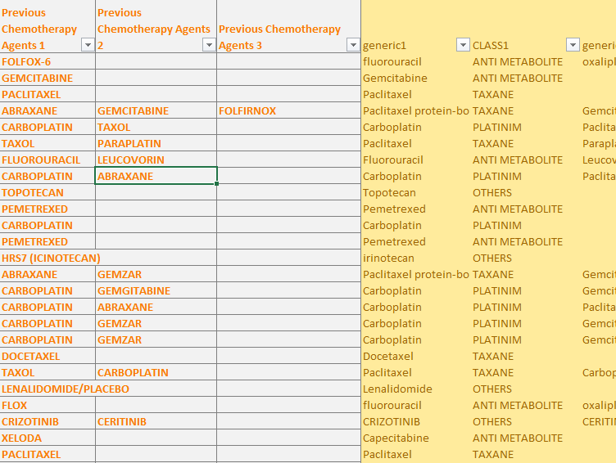
Recap
Label dataset of patient’s chemotreatments with class and generics
Folfox-6?
Abraxane?
Docetaxiieil?

Slide 7
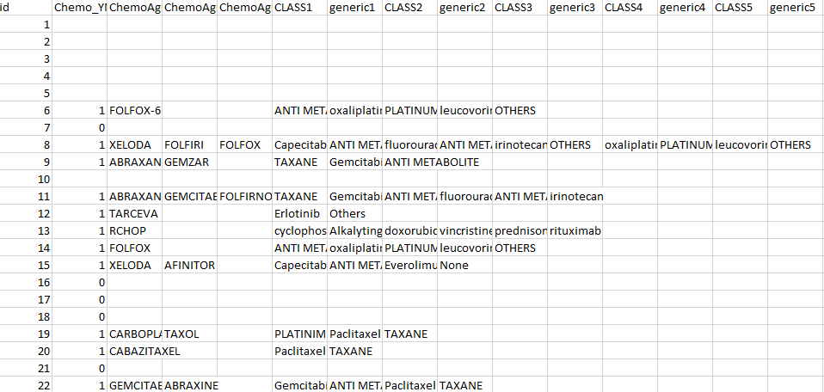
Out of the 541 rows of target data, there are 173 empty rows and 368 non-empty ones.
Among the 368 rows with data, after fuzzy text matching, 132 rows can be assigned generics and classes with certainty.
For the remaining 236 rows, we generated rules of association in the labelled data,and labeled most of them except around 42 treatments that don’t have any relevant info.
After having 42 treatments labeled, we have the clean result that looks like this→

Slide 8
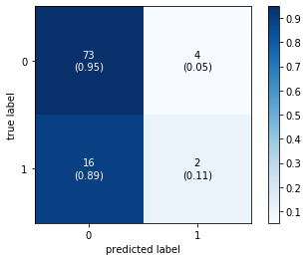
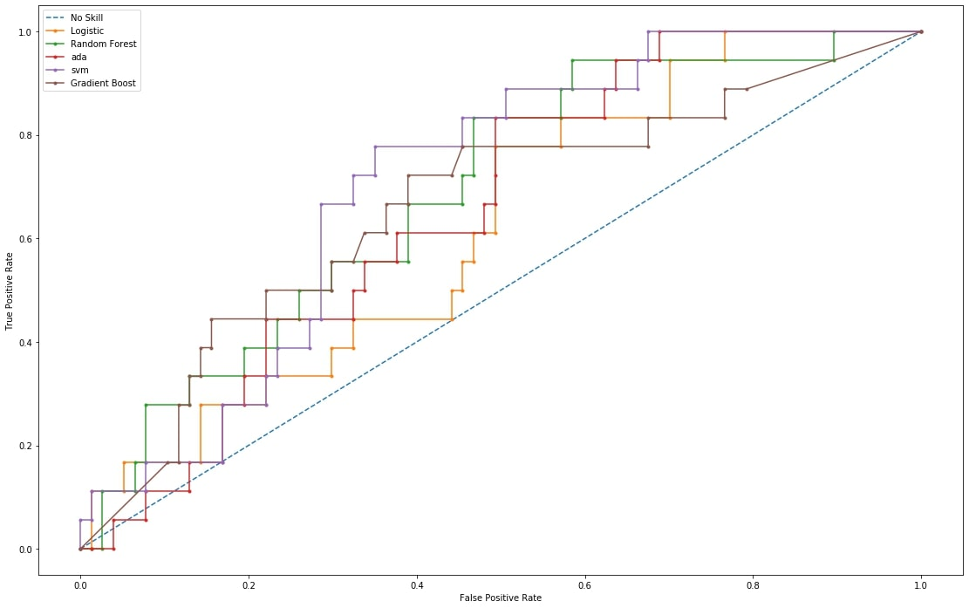
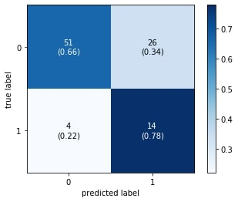
Cggphys2 (the remaining categorical)
Plain Logistic
Revised Svm
No Skill: ROC AUC=0.500
Logistic: ROC AUC=0.623
RF: ROC AUC=0.688
ada: ROC AUC=0.657
svm: ROC AUC=0.707
gb: ROC AUC=0.661

Slide 9
Transforming Regression Tasks into Classification
AGG_MENT
AGG_PHYS

Slide 10
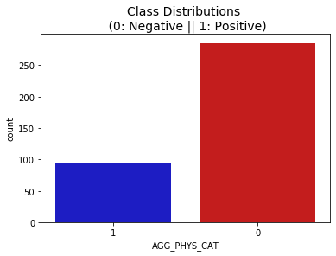
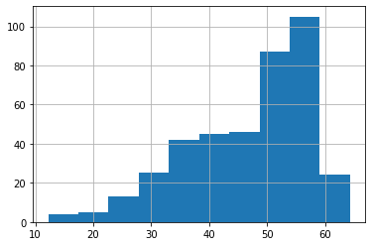
Aggregated Physical
Due to all categorical nature and lack of predicting power of the predictors, we found it hard to reduce RMSE (9-10) during regression task. Thus we consulted Prof Xu and transformed the continuous outcome variable into categoricals, cutting by first 25 quantile. This leads us to a similar imbalanced classification task like previous tasks.

Slide 11
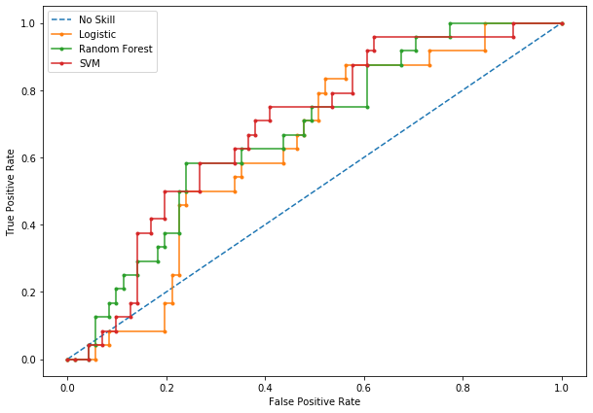
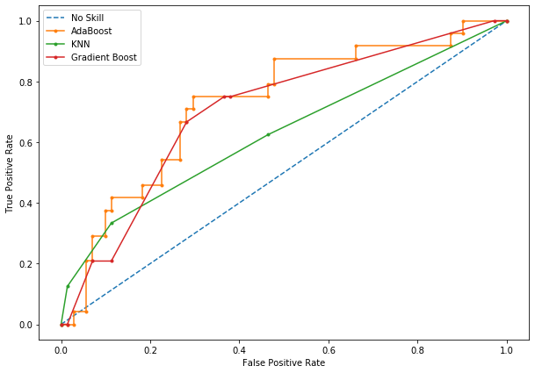
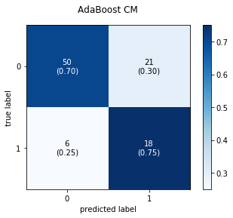
Aggregated Physical
AdaBoost: ROC AUC=0.726
KNN: ROC AUC=0.627
Gradient Boost: ROC AUC=0.705
Logistic: ROC AUC=0.629
RF: ROC AUC=0.673
SVM: ROC AUC=0.690
Thresholding at P=0.48 instead of 0.5

Slide 12
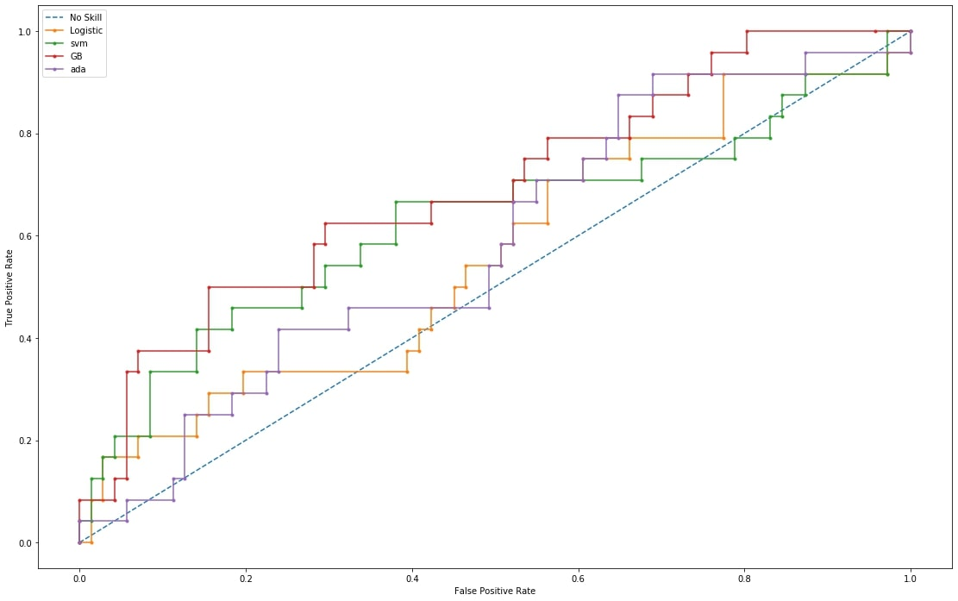
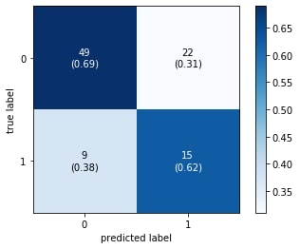
Aggregated Mental
No Skill: ROC AUC=0.500
Logistic: ROC AUC=0.562
svm: ROC AUC=0.627
gb: ROC AUC=0.691
Ada: ROC AUC=0.586

Slide 13
Next Steps
Present to URMC tomorrow.
Finish last outcome variable prediction (sf12)
If we have time, get a list of impacts of different chemo treatments, and incorporate part 1 variable into prediction, and how would that impact the models.
Notes:
Logistic Boosted TREES, H20

